Slide 1

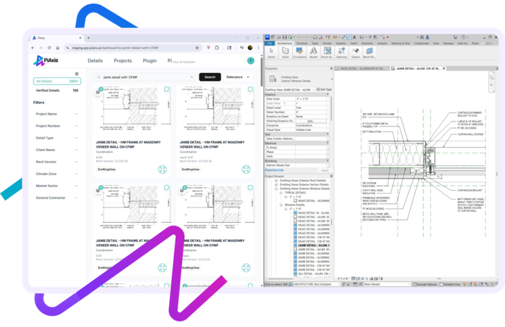




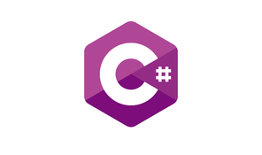




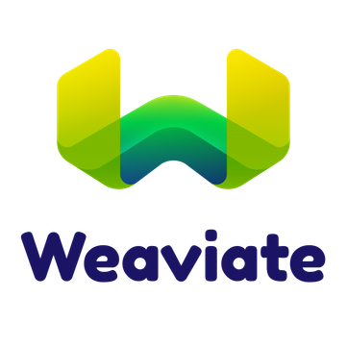


PIAXIS
AI-POWERED ARCHITECTURAL DETAIL MANAGEMENT PLATFORM
Construction Tech : PiAxis is an AI-powered architectural detailing platform built to help firms cut documentation time and scale project delivery with minimal manual effort. It automates repetitive Revit detailing, enforces firm-specific graphic standards across teams, and syncs in real-time through the Autodesk Design Automation API. Powered by intelligent AI agents, PiAxis lets architects focus on design instead of drafting.
Delivered a full-stack solution in 4 months
80% detailing time reduction
500-1,000+ annual hours saved per firm
99.5% system uptime with enterprise reliability
Industry
:
Architecture / Construction Tech
Technologies
Problem
:
Revit detailing eats 30–40% of project time.
Solution
:
AI Revit plugin with real-time API integration.
Impact
:
80% Faster, 1,000+ hours saved per firm yearly.

Slide 2

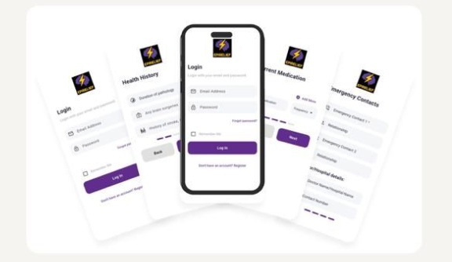








EPIRELIEF
SMART SEIZURE MANAGEMENT & EMERGENCY RESPONSE PLATFORM
Healthcare: Epilepsy Management Seizure Detection
EpiRelief helps individuals with epilepsy take control of their condition through smart seizure logging, medication management, and real-time emergency notifications.
Delivered in
6 months
60 % faster emergency response time
85% user adoption rate
92% seizure detection accuracy
Industry
:
Healthcare
Technologies:
Problem
:
Manual tracking & delayed response
Solution
:
Automated seizure logging & alerts
Real-time Notifications:
Impact
:
Faster response, improved patient safety
“EpiRelief has significantly improved how we monitor seizures and respond to emergencies.” — Clinical Program Manager

Slide 3

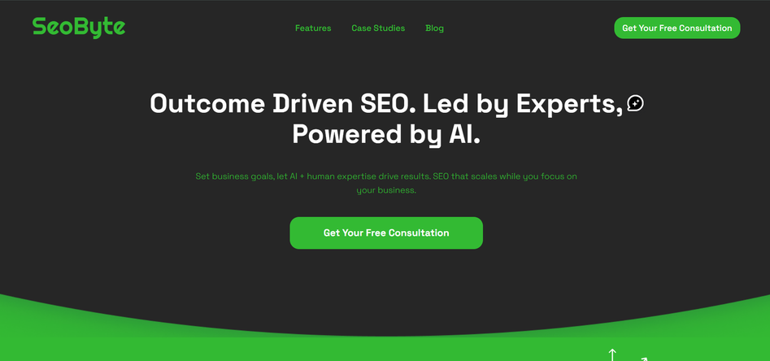







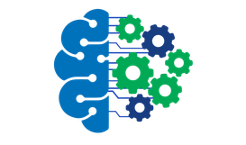

SEOBYTE
AI-POWERED SEO AUTOMATION & CONTENT GROWTH PLATFORM
Marketing Technology: AI-powered SEO automation platform that helps businesses accelerate organic growth through intelligent content strategy, analytics, and SEO task automation.
300% organic traffic growth in 3 months
80% reduction in SEO task time
multi agent platform in 3 months
20+ AI agents with full observability
90%+ workflow automation coverage
80% reduction in AI API costs through optimization
Industry
:
Marketing Technology / SEO
Technologies
Natural Language Processing (NLP)
GPT-based content generation
Problem
:
SEO research and audits take days of manual work.
Solution
:
20+ LangGraph agents with RAG and human-in-loop control.
Machine Learning models for SEO prediction
Proprietary AI agent architecture
Impact
:
99.6% faster, 90%+ automation, 3,080% traffic growth.
“SeoByte has been a game-changer for our online presence. Their strategies boosted our website’s visibility, improved search engine rankings, and led to a significant increase in inquiries and sales. Our brand’s online presence and business growth have never been stronger.”— Founder, D2C Smart Water Purifier Brand

Slide 4

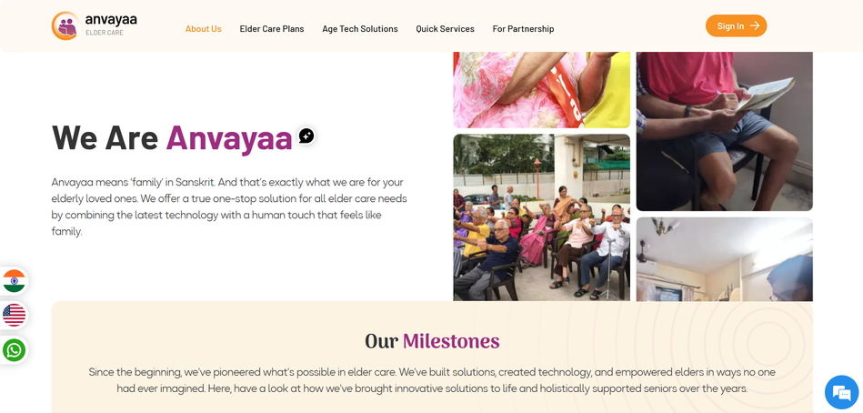





ANVAYAA ELDER CARE
SMART ELDER CARE MANAGEMENT & SUPPORT PLATFORM
Healthcare: Elder Care Management, Senior Citizen Services
Anvayaa Elder Care is a parent care platform that ensures elderly parents live safe, dignified, and emotionally supported lives when families are away. It acts as an extended family by combining on-ground support with dedicated care managers who provide trusted, long-term care coordination.
Delivered in
8 months
95% care quality satisfaction
5 minutes emergency
response operational
40+ cities across india
Industry
:
Healthcare / Elder Care / Senior Citizen Services
Problem
:
Technologies
Distant families lack reliable elder care.
Real-time Care Coordination
Solution
:
On-ground care managers across 40+ Indian cities.
On-ground support, regular check-ins, and proactive care management delivered through a centralized digital platform.
Impact
:
95% success rate, 5-min emergency response, reliability.
Anvayaa gives us peace of mind knowing our parents are cared for like family, even when we are miles away.”— Care Subscriber

Slide 5

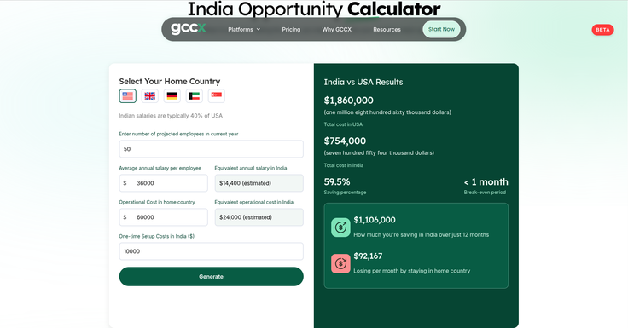





GCCX
AI-POWERED GLOBAL CAPABILITY CENTER (GCC) DECISION & SETUP PLATFORM
GCCX is an intelligent platform that helps global enterprises evaluate, plan, and initiate their India GCC setup through AI-driven insights, cost simulation, and structured request workflows. It enables leadership teams to make faster, data-backed expansion decisions with automated reports and real-time assistance.
Delivered in 4 weeks
80 % faster setup time
70% cost reduction for global teams
98% success rate
Key Capabilities :
AI Insights Assistant
India Opportunity Calculator
Request Submission Workflow
Automated Reports
Industry
:
Global Capability Centers
Problem
:
Enterprises lack a centralized, data-driven system to evaluate GCC expansion opportunities and manage setup requests efficiently.
Technologies :
TypeScript (Supabase)
Solution
:
AI-powered insights, cost simulation, and automated reporting in a single decision-support platform.
OpenAI
Impact
:
Faster GCC decision-making, structured request management, and improved leadership visibility into India expansion opportunities.
Next.js
Resend

Slide 6

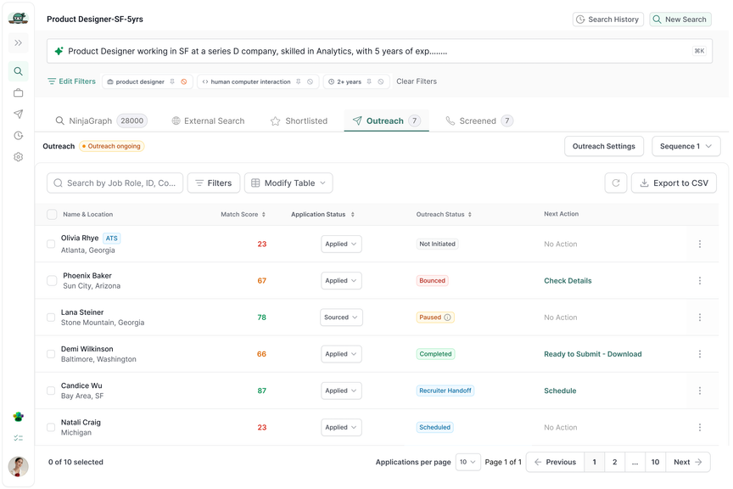




NINJAHIRE
AI-POWERED TALENT ACQUISITION COPILOT & HIRING WORKFLOW AUTOMATION
Primary Category
:
Recruiting & Talent Acquisition
Core Product Tags
:
Talent Acquisition Copilot, Hiring Workflow Automation
Ninjahire is an AI-powered recruitment agent designed to act as a dedicated co-pilot for hiring managers and recruiters. Through natural conversational workflows, it manages the entire hiring lifecycle — from generating optimized job descriptions and sourcing qualified candidates to coordinating interviews and streamlining communication — all within a unified interface.
Delivered in 2 Months
Enhanced recruitment efficiency by 90%
Reduced hiring time up to by 75%
Improved candidate quality by 85%
Industry
:
HR Tech / Recruiting & Talent Acquisition
Problem
:
Recruiters lose 2 days per cycle on screening, follow-ups, and scheduling across scattered tools.
Technologies :
TypeScript (Supabase)
OpenAI
Solution
:
LangGraph supervisor orchestrating 20+ agents with Microsoft Teams integration.
Next.js
Resend
Impact
:
90% faster screening, 60% cost-per-hire cut, 80% automation, 10x candidate volume.

Slide 7
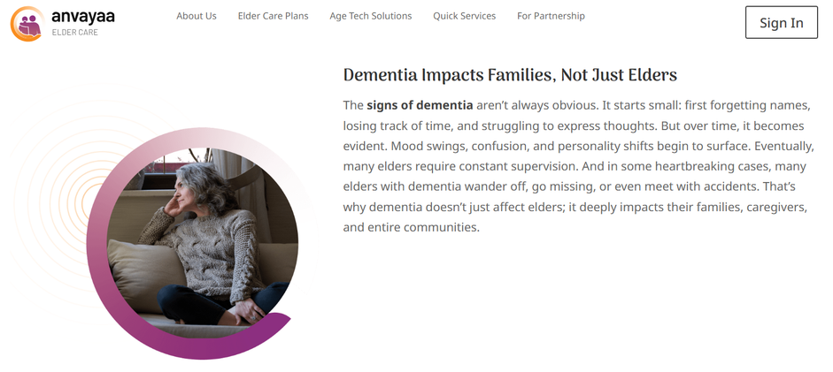



DEMENTIA CARE ANVAYAA
SMART DEMENTIA CARE & CAREGIVER SUPPORT PLATFORM
Dementia Care Anvayaa is a dedicated caregiving application designed to make dementia support more structured, personalized, and effective for both caregivers and families. It brings together tailored cognitive activities, smart reminders, expert consultations, and service booking in a single platform to simplify daily care management.
Delivered in 6 Months
6+ AI systems
3x daily patient engagement with personalized games
5/5 star rating with positive family testimonials
Industry
:
Healthcare, Elder Care, Dementia Care, Caregiver Support
Technologies :
TypeScript (Supabase)
OpenAI
Problem
:
Caregivers struggle to manage structured dementia care, track routines, and provide consistent cognitive engagement.
Next.js
Resend
Solution
:
A single platform for personalized activities, reminders, expert support, and service coordination.
Impact
:
Reduced caregiver burden, improved patient engagement, and better daily care consistency.

